Slide 1
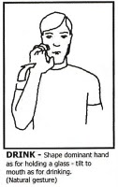
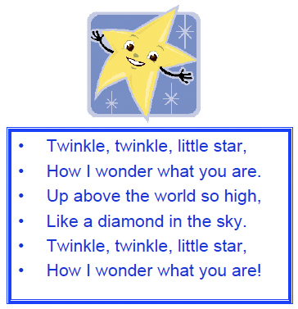


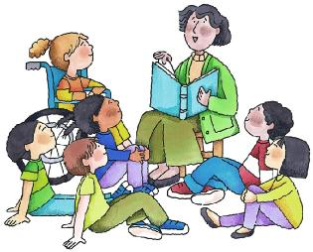
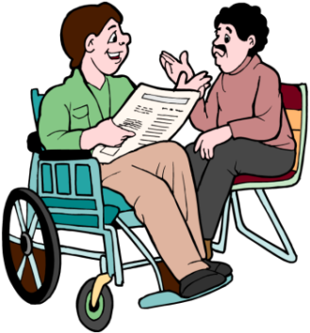

Communication and Language

Slide 2
CL
This area of learning
is split into 3 sub heading:
Listening and attention : is about how children listen attentively in a range of situations.
They listen to stories, and respond to what they hear with relevant comments, gurgles, gestures, questions or actions. They give their attention to what others say and respond appropriately (which may be smiling, laughing, crying, moving away or more eloquently as they grow older)
Undertsanding: is about how children respond to and follow sentences, instruction or questions. How they respond to humour, begin to understand ‘how’ and ‘why’
Speaking is how children express themselves effectively, showing awareness of listeners’ needs. They develop their own narratives and explanations by connecting ideas or events
Activities at Home
Read stories
Give children clear direction
Talk things through together
Talk about the story, looking at pictures (for babies texture books are good)
Chat, talk, whisper, sing with your child

Slide 3



Personal, Social, Emotional Development

Slide 4
PSED
This area of learning splits into 3 sub headings:
Making relationships : is about how a child plays alongside others, taking turns and showing sensitivity to the needs of others; showing affection and enjoying social interaction.
Self-confidence and self-awareness is about how we support the child to become confident and active learners, happy to express their own preferences and act independently in the setting.
Managing feelings and behaviour examines how children care for one another, responding their own feelings and to those of others. It is about how they function in a community, as a group, yet still retaining their own identity. They understand their are rules and boundaries and why they are in place.
Activities at home
Play games to encourage taking turns and sharing
Talk about how things make you and your child feel. Encourage them to think about how their actions might make others feel.
Encourage independence by allowing self feeding, using appropriate cutlery
Praise your child as much as possible for the great things they do, however small.

Slide 5



Physical Development

Slide 6
PD
This area of learning splits into 2 sub headings:
Moving and Handling is about how children learn to control their bodies both through gross and fine motor skills. This includes moving in a variety of ways with good co ordination and also how they handle tools and equipment effectively. This includes holding pencils ready for writing.
Health and safe care is about how we teach our children the importance of a healthy lifestyle: both in the foods we introduce them to and the amount and variety of physical activity they receieve. It is about basic hygiene and self care (toilet training, washing hands, self dressing and feeding)
Activities at home
Play ball games
Take a trip to the park
Talk about how their bodies feel after running
Scissors and paper are some easy and effective resources
Take a pot of water and a large paintbrush outside so your child can “paint” the pavement, fence, or walls
Have interesting objects hanging from your pram or buggy.

Slide 7
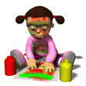
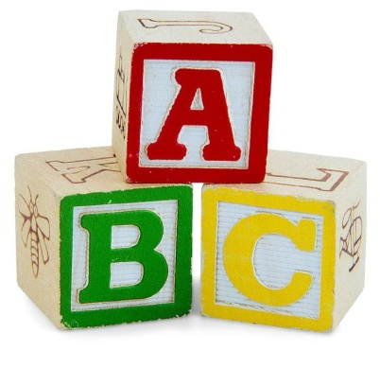
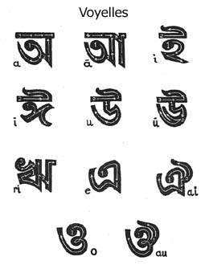
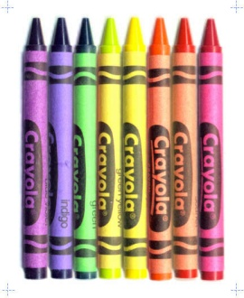

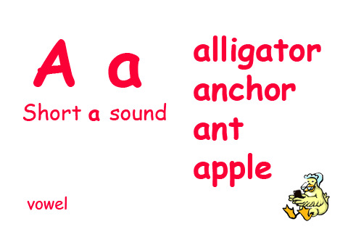
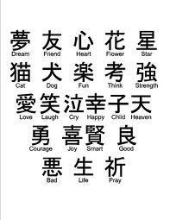
Literacy

Slide 8
LITERACY
This area of learning splits into 2 sub headings:
Writingis about how children give meaning to marks as they paint and draw and identify marks they see in different places. In time they grow to use phonic knowledge to write words to match their spoken sounds.
Reading is about how children recognise rhythm, how they listen to stories with increasing attention and can retell narratives: describing events and characters. They recognise that information can be retrieved from books and eventually use phonic knowledge to decode words to read accurately.
Activities at home
Read with and to your children: as much as you can!
Make up stories together.
Look at road signs as you are out and about
Encourage your children to write as much as possible (even if it is “scribble”): write lists, letters, notes.
Have mark making materials readily available: post it notes and pencils.
Talk about and explain what you write and let them see you writing
Play eye spy to introduce them to the world of phonics.

Slide 9
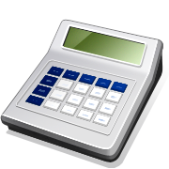


Mathematics

Slide 10
MATHS
This area of learning splits into 2 sub headings:
Numbers is about how children develop an awareness of numbers through day to day play: through songs, routines, grouping, counting, sorting and comparing. We note how they become aware of numerals, especially those of presonal significance and recognise numbers in the wider environment.
Shape, Space, Measures is about how children notice patterns and shapes in the world around them. It looks at how they use the language of mathematics to talk about size, weight, capacity, position, distance, time and money and how they use mathematical thinking to solve problems.
Activities at home
Look at numbers you see whilst out and about: on road signs or house numbers
Make a game of sorting socks after washing
Sing number rhymes such as ‘1,2,3,4,5 once I caught a fish alive’
Count out cutlery for dinner, or making sure all the people (or dolls, bears) each have a cup. When filling cups use language relating to quantity: “is it full yet? Do you need more?”
Tell stories with numbers and counting in, eg 3 little pigs or Goldilocks and the 3 bears

Slide 11




Understanding the World

Slide 12
This area of learning splits into 3 sub headings:
People and communities is about how children show an interest in the lives of people who are familiar to them. They gradually begin to see similarities and differences between themselves and others
The World is about how children notice features in the environment, observing what animals, people and vehicles may do. They become interested in how and why things work, looking for answers and thinking about change.
Technology is about how children show an interest in toys with buttons and simple mechanisms and grow to operate them, achieving effects such as sound and movement through control measures. They ultimately seek technology for particular purposes.
UW
Activities at Home
Talk to your child about your family, culture, religion, where you live
Talk about what they see, hear, smell, taste and touch
Help them with simple computer games (Cbeebies web site is a great start)
Go for a walk and look at the world around you
Find some junk and get modelling

Slide 13
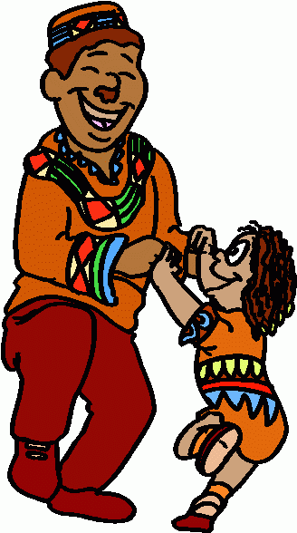

Expressive arts and Design

Slide 14
CD
This area of learning splits into 2 sub headings:
Exploring and using media and materials includes how children respond to music and sound and how they experiment with different resources for making marks, both in 3d and 2d.
Being imaginative is about how children pretend one object represents another and how they develop make believe play by pretending and role play. They will develop to represent their own ideas, thoughts and feelings through a variety of different media, using available resources to create props to enhance their play.
Activities at home
Be prepared to be the passenger on your child’s train or accompanying her on a mission to save the planet
Raid the cupboards for materials: pasta and rice for shakers, cardboard tubes and boxes for models
Visit charity shops for exciting dressing up clothes
Make some gloopy paint from flour, water and some food colouring.

Slide 15

Parent’s guide to the (revised)
Early Years Foundation Stage (EYFS)
This guide outlines the different areas of learning as well as suggestions for ways to help your child at home.
Most importantly you should have fun and play together!

