Slide 1
Little Star Nursery Farrington Gurney
Emily Crawford
Children ranging from 1 to 5 years

Slide 2
How can we organise the outside space to engage the children’s interests ?
Through observation we highlighted that the children were much less engaged in their play in the outside environment.
We noted that the children were showing an interest in using construction materials but the play didn’t seem overly sustained.
The inside environment and thesis of the nursery is very much zoned but child led. The resources are available to the children all of the time and in specific areas so I decided to continue this to the outside.

Slide 3
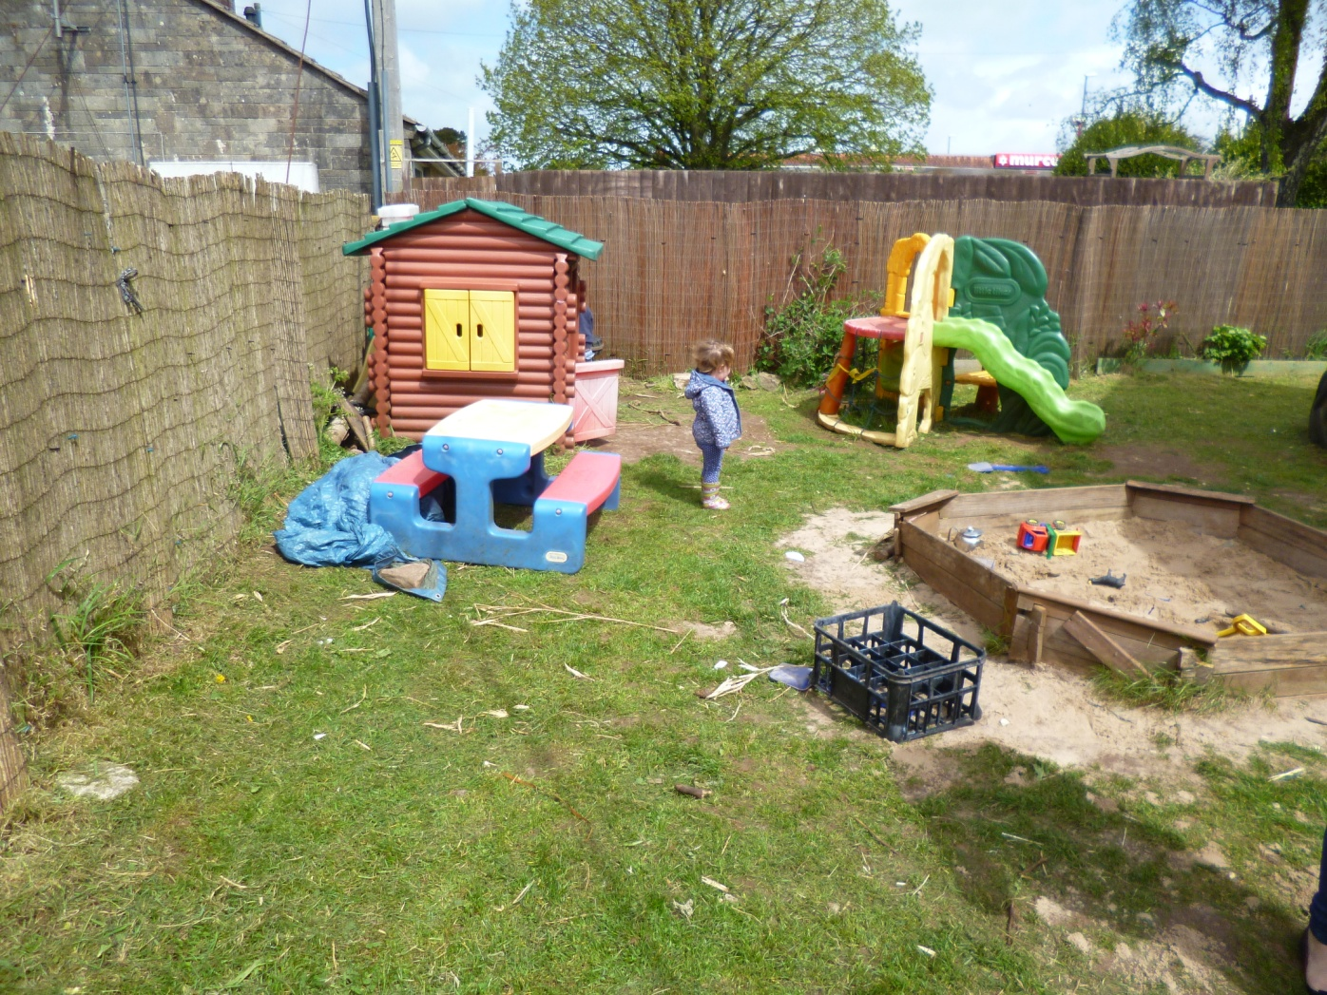
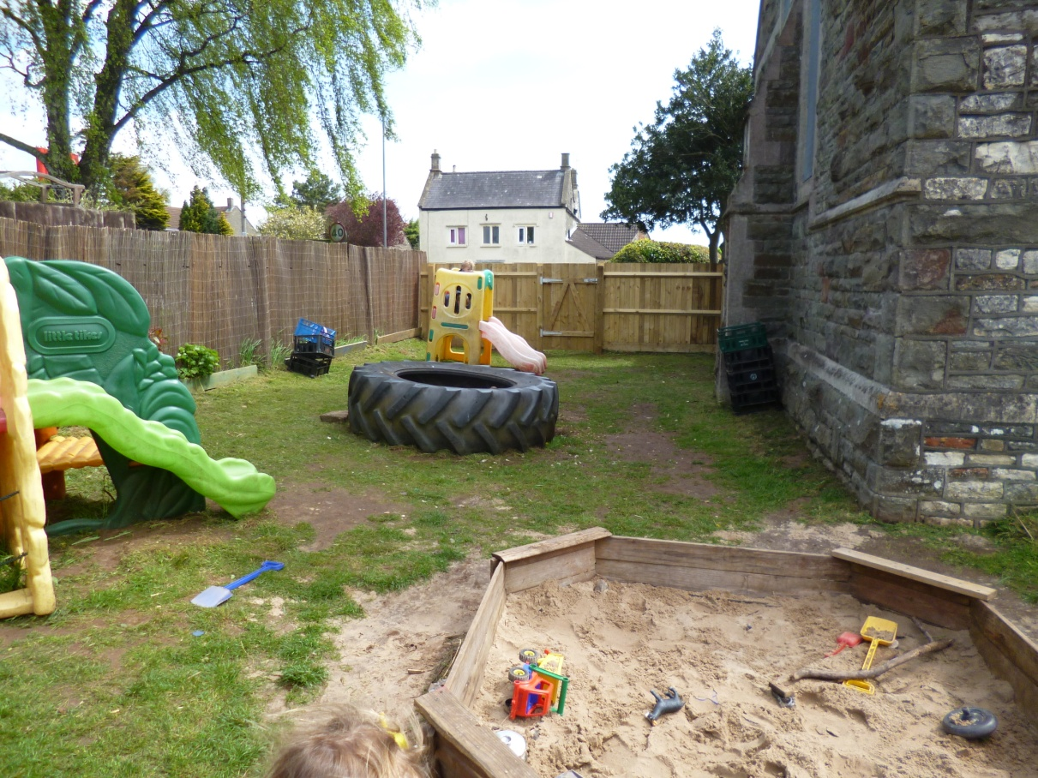
Starting point:
We needed to think about how we as adults perceive the space we have.
But also how the children see and perceive the space as their point of view could be different.
We have a large outside space so how do we make it an engaging space?

Slide 4
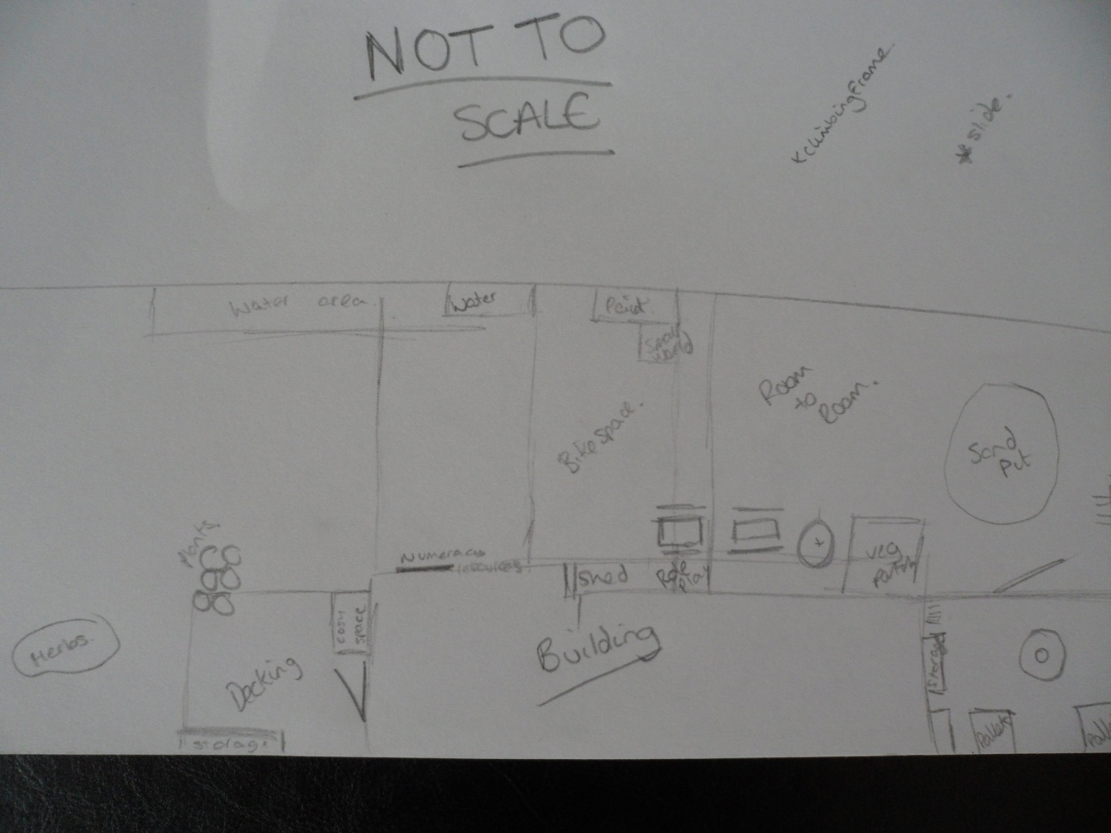
First things first, a plan!
Notes:
To begin, I consulted the other staff members to get a rough idea of how they thought the space could be enhanced. After this discussion and the discussion with Liz Elders we had a sketch of what we wanted to do. We moved the large equipment before the children came out the help with the transformation.
One child’s reaction was “wow its like a whole new garden” she said this with such excitement and wonder.
The children were then asked as a team to listen to each other and decide where they thought the large scale construction equipment should be organised.
The children at first found it difficult to work together as a team as they had their own ideas, but with support they came together to create a space that suited them.

Slide 5
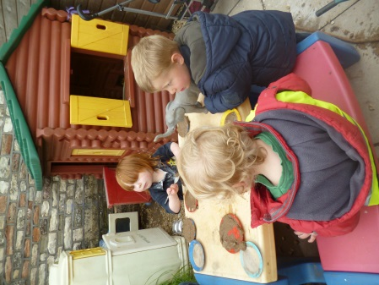
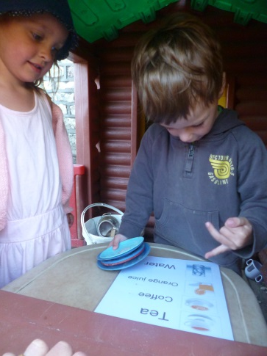
Wow! Its like a whole new garden!!”
Notes:
This quote has stayed with me through out the project. The changes had made such a big impact to this childs perception and view of the garden it was like she couldn’t believe it was the same space she had been playing in that morning.
Since the changes have been made we have all noticed as a team a significant change in the play. The children are now much more focused and interactive with each other. The children are now making a beeline for the ‘role play area’ it has become a cafe, a house, a raft. The construction area has become a favourite area for most of the children but the preschoolers in particular. This has allowed the children the opportunity to create their own places and spaces to play. I have one example of their observed play here

Slide 6
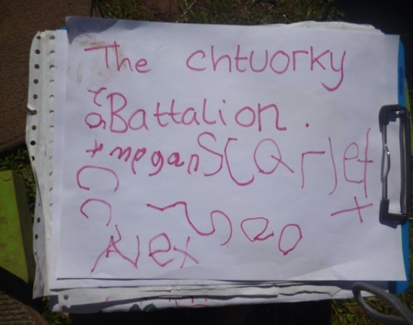
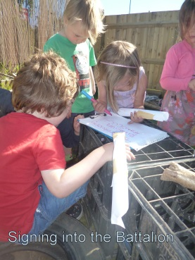
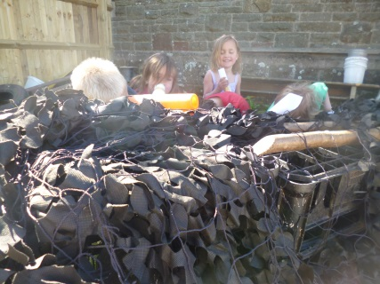
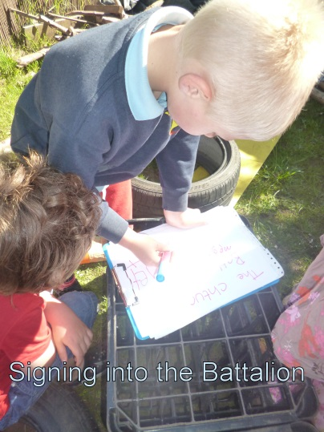
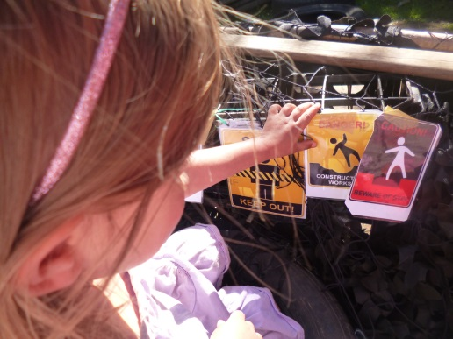
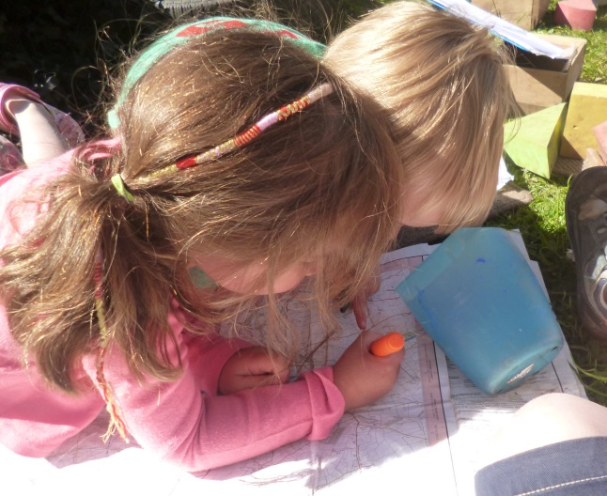
CREATIVITY!
Notes:
A group of 5 children (all 4 year olds) came out into the garden and headed for the “loose parts” construction area. Once there, one boy asked an adult to make him a gun from paper, a suggestion that was then picked up on by all the other children. Hence we were left with an “army” of children ready for battle. Although completely supportive of gun play as an important role play theme for these children to explore, the adult was also aware that their vigorous, active play which extends across the whole garden that was threatening the play of other, younger or quieter children.
A suggestion that they needed a look out was made. From there on their play assumed a much more focussed and controlled direction.
They eagerly took up the challenge and created their army barracks out of available resources (pallets, crates, tyres). The adult added a camouflage net to add to the effect. Having had their energies honed in on creating their base, they then took pride in “shooting” from it. Having assumed this area of the garden for this type of role play, the other children accepted the rules and the younger children who wanted to join in could, whilst the other children were left happily and uninterrupted to enjoy the other parts of the garden.
“What’s the battalion going to be called?” (to which the adult had to explain the meaning of the term).
One child suggested an imaginary word. “How do you spell that?” the adult queried and he used his phonics knowledge to do just that: we ended up with “The Chtuorky” Batallion.
Next, all members of the battalion had to sign in (practice in writing/ mark making: which was a great opportunity for some boys who are reluctant writers to test out their skills). The game then progressed in a much more manageable and less threatening manner.
Having got the children’s attention and co operation we were then able to go on to explore other things: such as using a map to work out where the enemy lines were (covering areas of learning such as reading, writing and creative thinking as they identified features of the map, marked where the enemy was, and even led on to talking about rivers, castles and moats!). We used signs such as ‘Danger: Keep out’ that again encouraged reading skills and throughout there was a lot of co operation, team work and collaboration; working out of feelings : (the adult: “Why is [child s] looking sad?” boy A: “Because B told her to guard camp”. The adult: “I don’t think it looks as if she is happy with that. I think we should make her happy again”. Child B “Sorry, [child s]”. Child D then offers “I’ll guard camp instead” and [child s] once again rejoins the group happily.
“That’s a ‘d’ for ‘danger’ “
It did rely on the practitioner to be able to direct the play, in a way that supported and extended children’s learning while they thought they were “just” playing armies!

Slide 7
Aftermath
Reigniting their imaginations
Extending creativity
Influences on children, staff, setting.
Notes:
Reigniting their imaginations. Before I started the 5x5x5 creativity my opinion of the outside space was that it needed a bit of love but I wasn't sure how to go about changing it. From doing the course it has made me think about the open ended possibilities that a space should offer. I still believe that there is a place for climbing equipment however creative opportunities are born from open ended, and often natural materials.
Extend their creativity. The role of the adult is crutial to extend and scaffold the childrens learning and imagination. From the earlier example of creative play it is possible to see that the adult with the children helped to guide and progress the learning whilst letting the children take the lead in what they wanted to do and keep the essance of the play. They used make making, team work, using maps, large scale construction, reading, writing the list goes on.

Slide 8
Influence on the children.
The creations
The vocabulary
The extended learning.
Notes:
The children seem to have a much more creative spark about them now that the garden layout has been zoned. The children are using the resources in a much more engaged manner and it is encouraging the children to come together in play that is sustained. The play is encouraging the children's creativity, the practitioners are then able to interject suggestions to extend that learning but also to provide resources such as menus for the children to explore language and print.

Slide 9
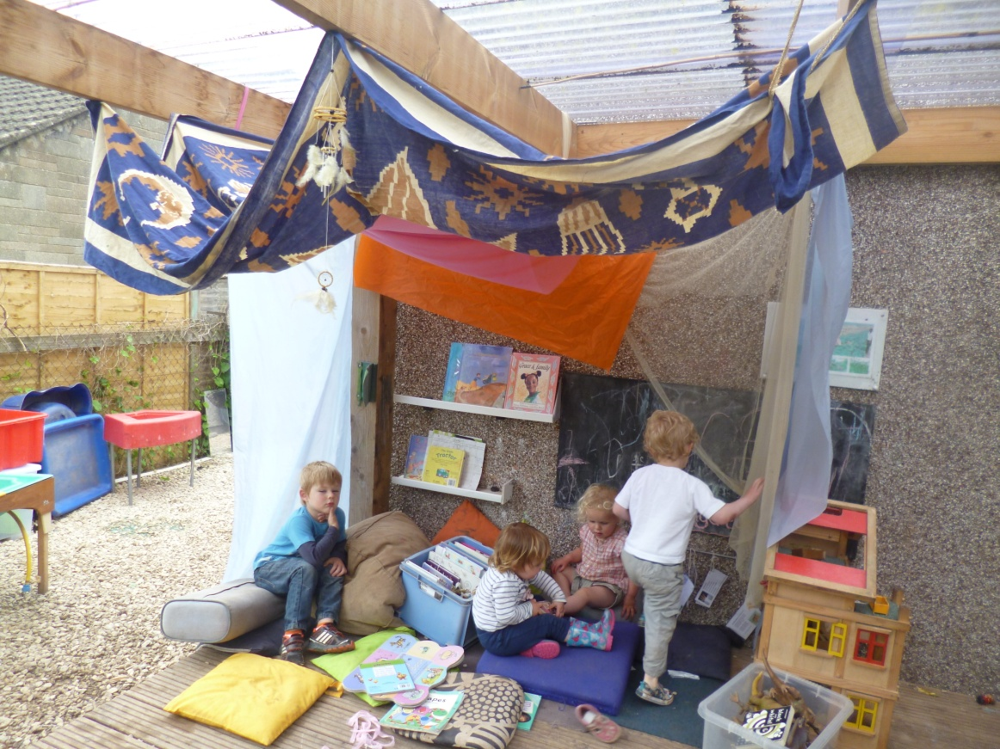
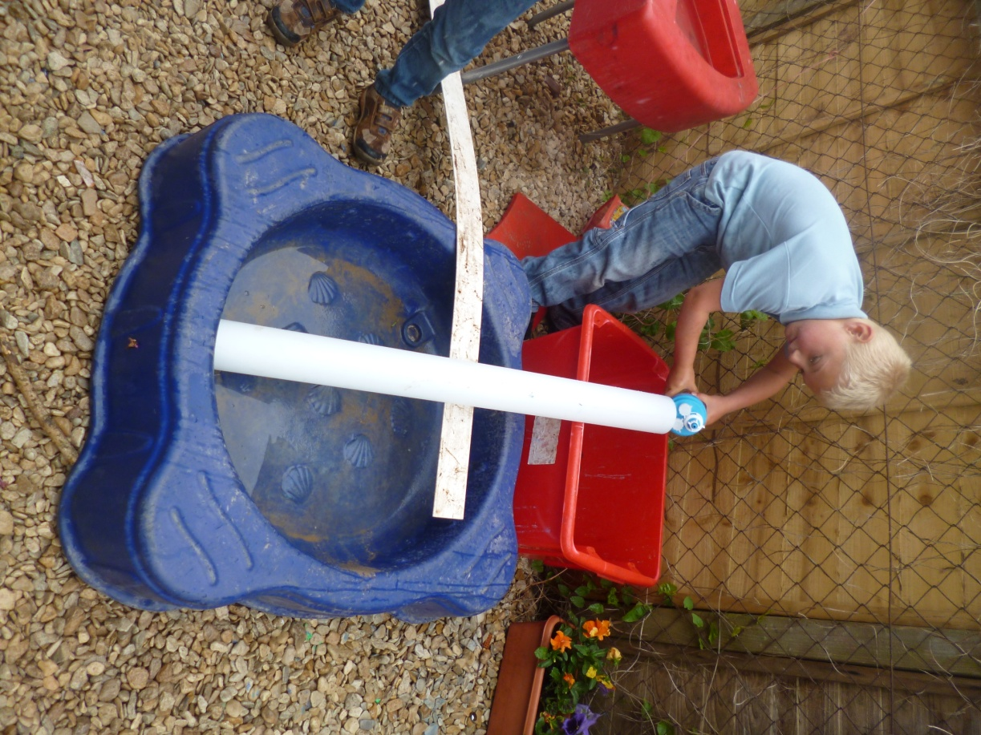
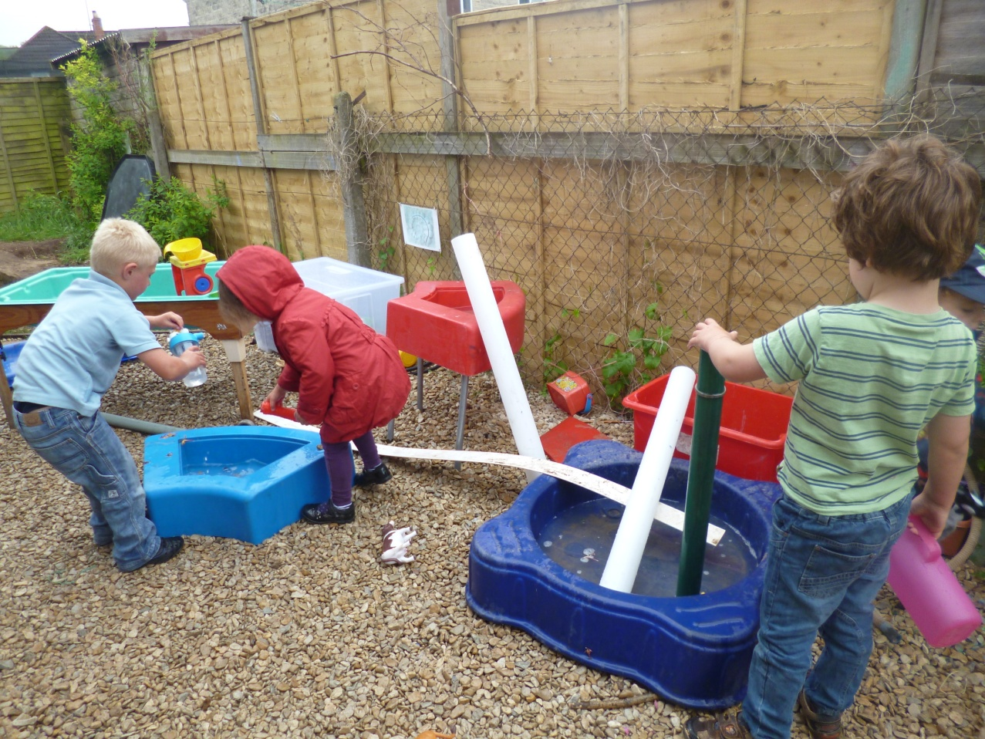
Plan for continuation
Further development
Water area
Decking area
Bug hunting
Notes:
Further development.
Since the garden has been rearranged we have also made changes to the top of the garden. We have begun to make a water area that has tubes, funnels, watering cans, animals, and all sorts of containers. We are aiming to add more resources in the coming weeks.
The decking area has been given some attention too, we have redone the cosy area adding some song cards, more cushions, drapes and some small world resources (dolls house, cars and garage).
Other resources that have been inspired by the changes are bug hunting kits for the children to explore mini beasts and other microscopic discoveries.
There are lots of things still to do, better storage for equipment development of existing spaces. But now we have been inspired!

